Slide 1
Hill Climbing
Thee Approaches

Slide 2
Hill Climbing
Hill climbing is a local search method that uses an iterative improvement strategy.
The strategy is applied to a single point - the current point (or state) - in the
search space. At each iteration, a new point x’ is selected by performing a small displacement or perturbation in the current point x, i.e., the new point is selected in the neighborhood of the current point: x’ ~ N(x)

Slide 3
Hill Climbing Contd.
Termination occurs when one of the following stopping criteria is met:
No further improvement can be achieved.
A fixed number of iterations have been performed.
A goal point is attained

Slide 4

Hill Climbing Contd.
procedure [x] = hill-climbing(max it,g)
initialize x
eval(x)
while t < max it & x != g & no_improvement do,
x’ ~ perturb(x)
eval(x’)
if eval(x’) is better than eval(x),
end if
end while
end procedure
Algorlthm3.1:Astandard(simple)hill-climb~gprocedure.
66

Slide 5
Weaknesses of Hill Climbing1
Terminates at local optima solutions.
Second, there is no information about the distance from the solution found and the global optimum.
Third, the optimum found depends on the initial configuration. Finally, it is generally not possible to provide an upper bound for the computational time of the algorithm.
An important aspect of this algorithm, however, is that it provides blind search.

Slide 6
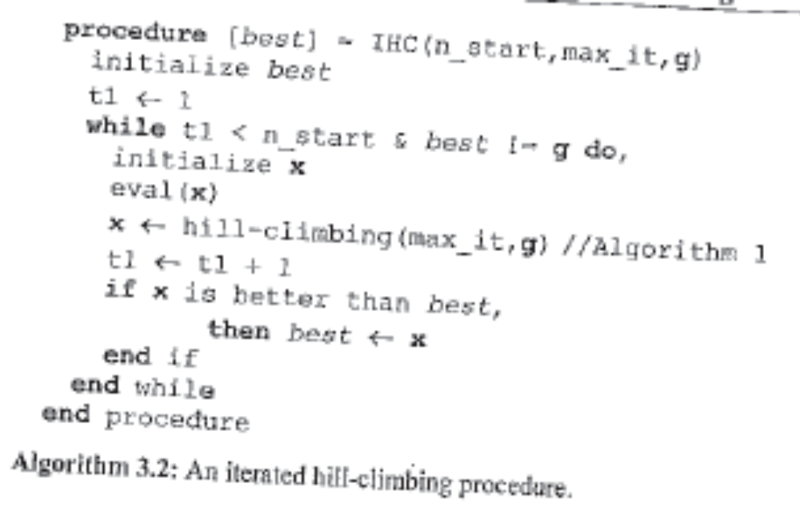
An Iterated Hill Climbing

Slide 7
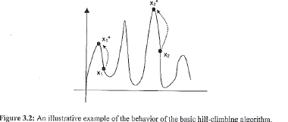
Behavior of Hill Climbing

Slide 8
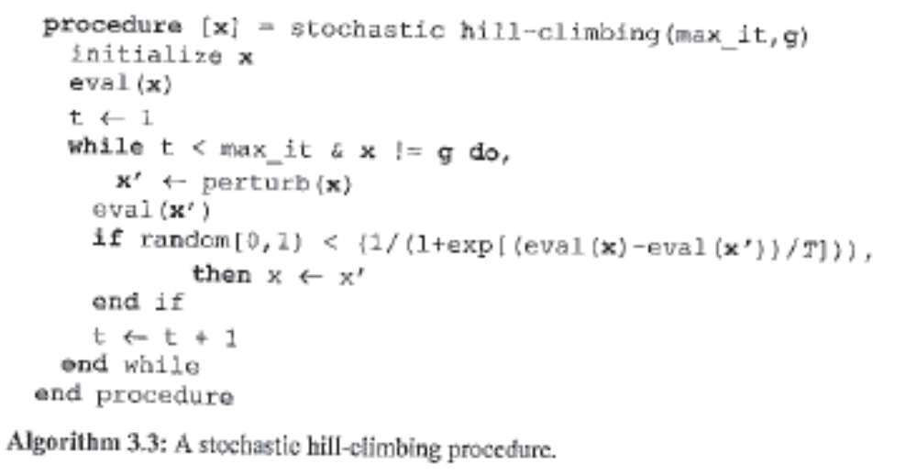
Stochastic Hill Climbing

Slide 9
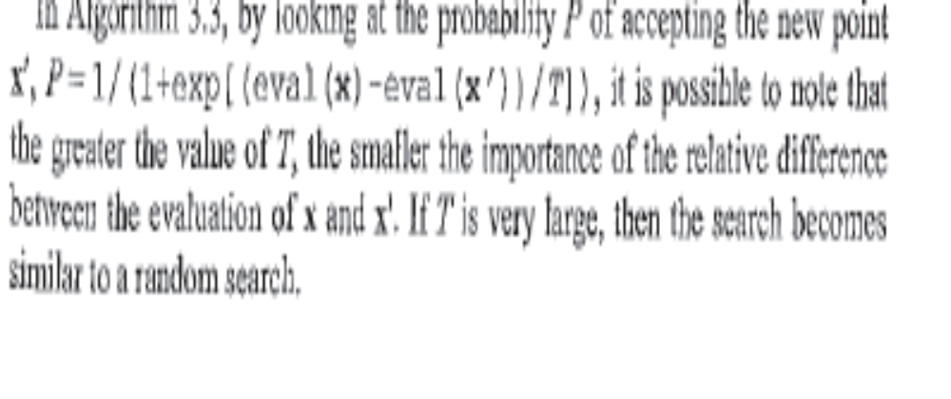
Random probability to Pick next X

Slide 10
Simulated Annealing
The simulated annealing (SA) algorithm, proposed by Kirkpatrick et al. (1983),
was inspired by the annealing process of physical systems. Annealing corresponds to subjecting a material (e.g., glass or metal) to a process of heating and slowly cooling in order to toughen and reduce brittleness

Slide 11
Definition of Annealing
The temperature of the melt is then slowly lowered so that at each temperature the atoms can move enough to begin adopting a more stable orientation. If the melt is cooled down slowly enough, the atoms are able to rest in the most stable orientation, producing a crystal. This heating followed by a slow cooling process is known as annealing.

Slide 12
Propose Equivalent of Temperature
Parameter for Optimization
Kirkpatrick proposed that the process of finding a
low temperature is akin to finding the low energy of
the physical system.
In a combinatorial Optimization problem any cost function
can play the role of energy of the system. Thus we have
to propose a parameter which is equivalent to the
temperature parameter.

Slide 13
Basic Principles of Statistical Thermodynamics
In statistical thermodynamics large systems at a given temperature approach spontaneously the equilibrium state, characterized by a mean value of energy, depending on the temperature. By simulating the transition to the equilibrium and decreasing the temperature, it is possible to find smaller and smaller values of the mean energy of the system (Cern~,, 1985).
Let x be the current configuration of the system, E(x) the energy of x, and T the temperature. The equilibrium is by no means a static situation. In equilibrium, the system randomly changes its state from one possible configuration to another in such a way that the probability of finding the system in a particular
configuration is given by the Boltzmann-Gibbs distribution:

Slide 14
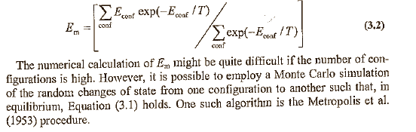
Boltzmann-Gibbs distribution
P(x) = K.exp(-E(x)/T) 3.1
K is the Boltzmann constant
If we assume a system with a discrete number of possible states, then the mean energy Em of the system in equilibrium is given by

Slide 15
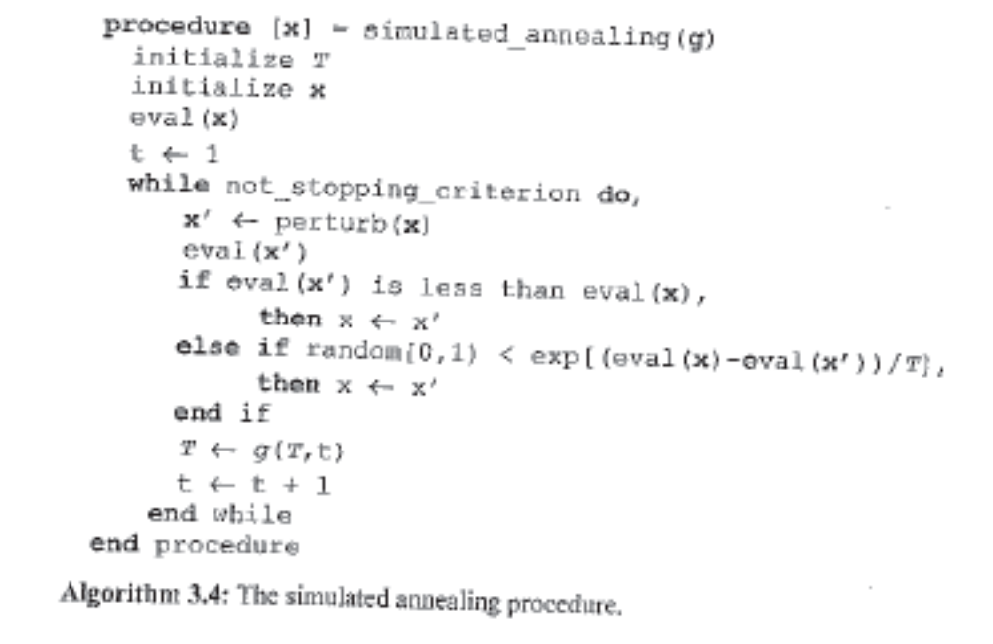

Slide 16
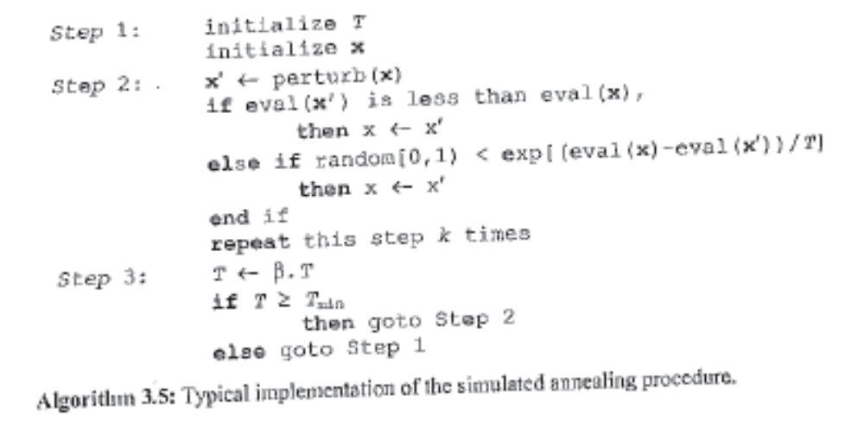
Implementatation of SA

Slide 17
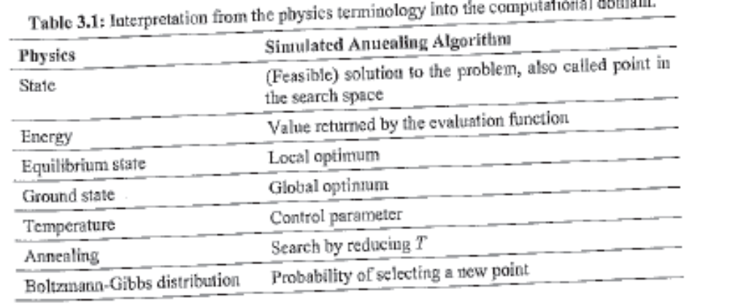
Thermodynamics to Computing

